Slide 1
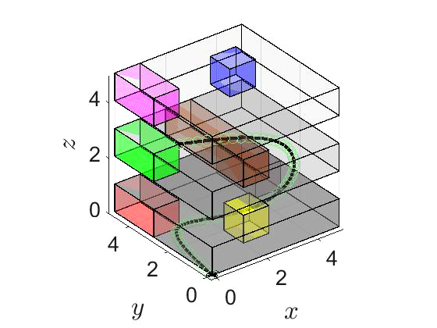
CoT-TL: Low Resource Temporal Knowledge Representation of Planning Instructions using Chain-Of-Thought Reasoning
- Kumar Manas^{1,2}
- Stefan Zwicklbauer²
- Adrian Paschke¹
[1] Freie Universitat Berlin, Germany
^{[2] Continental AG, Germany}

Slide 2
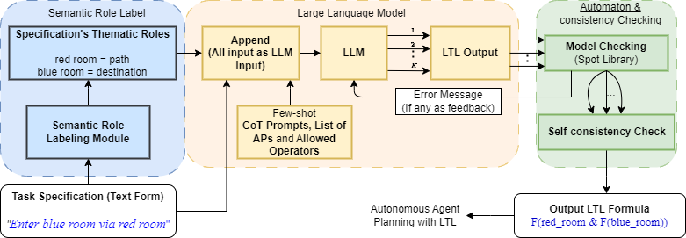
CoT-TL: Natural Language to LTL

Slide 3

CoT-TL: Natural Language to Text

Slide 4
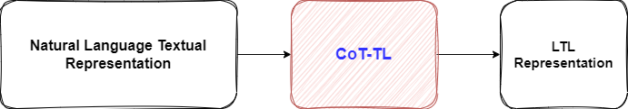
CoT-TL: Natural Language Text to LTL

Slide 5
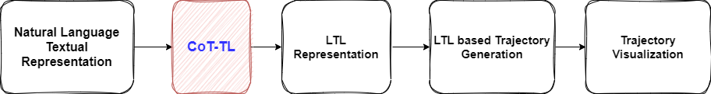
CoT-TL: Natural Language Text to LTL

Slide 6
Demo: Interpretable LTL & Simulation

Slide 7
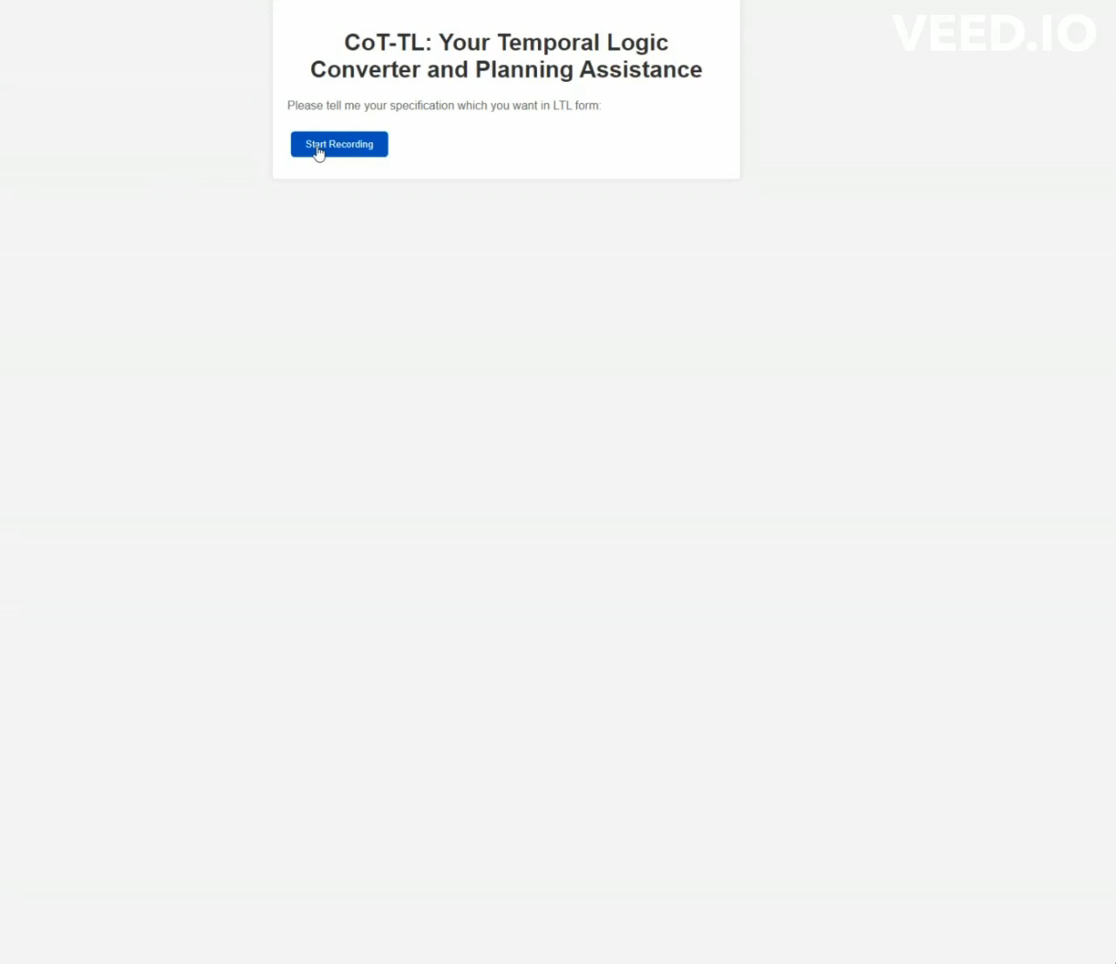

Slide 8
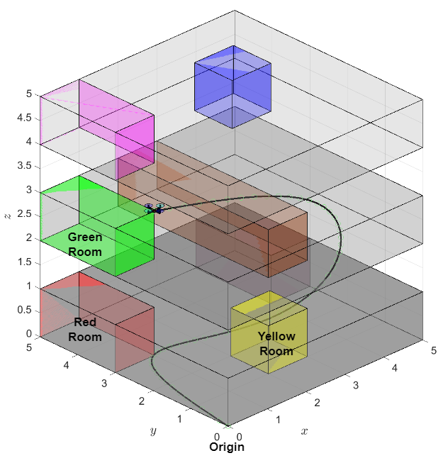
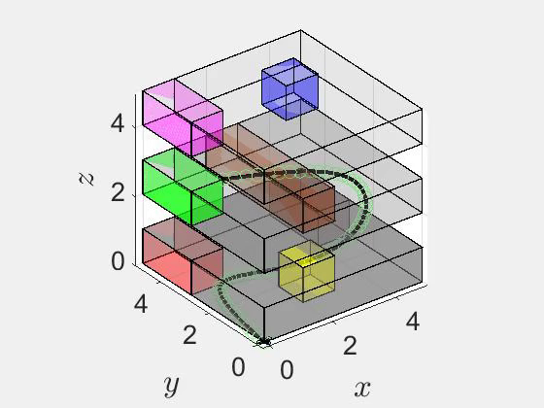
Demo: Interpretable LTL & Simulation
Even if a few shot prompts have two-step navigation, COT-TL is successful in new situations having 3 step navigation LTL formula creation!! Generalization !!
F (red_room & F (yellow_room & F (green_room )))
1st step 2nd Step 3rd step 8
4X speed
Annotated View of Drone Planning route

